Slide 1

Knoxville M365 Community Day Power Up Your Personal & Professional Productivity with Agile Principles using OneNote, Loop, & More

Slide 2


B2B Technology Company focused on M365, process-based innovation, enterprise architecture, and fractional CTO services.
Davis G. Trent
Principal Consultant
davis@mach11.co

Slide 3
Agenda
Inspiration
Agile refresher
Scrum refresher
Self audit
Personal productivity
OneNote
Templates
Side quest (PARA)
Team/Org collaboration

Slide 4

💡Inspiration*
*Meier, J.D. Getting Results The Agile Way. 2010. https://gettingresults.com/getting-results-the-agile-way/
https://www.linkedin.com/in/jdmeier

Slide 5
🔄️ Agile Refresher
February 11-13 2001 - Lodge at Snowbird ski resort (UT): Agile Software Development Manifesto
Representatives from: XP, Scrum, DSDM, ASD, Crystal, FDD, PP
Move away from process-heavy, documentation-driven development processes
Main takeaways:
Common values
Trust and respect
Base all things on people, collaboration, and building organizations you’d like to work in
source: https://agilemanifesto.org/history.html
Notes:
XP = eXtreme Programming
DSDM = Dynamic Systems Development Method
ASD = Agile Systems Design
FDD = Feature Driven Development
PP = Pragmatic Programming

Slide 6
Manifesto for Agile Software Development
We are uncovering better ways of developing
software by doing it and helping others do it.
Through this work we have come to value:
Individuals and interactions over processes and tools
Working software over comprehensive documentation
Customer collaboration over contract negotiation
Responding to change over following a plan
That is, while there is value in the items on
the right, we value the items on the left more.
Kent Beck
Mike Beedle
Arie van Bennekum
Alistair Cockburn
Ward Cunningham
Martin Fowler
James Grenning
Jim Highsmith
Andrew Hunt
Ron Jeffries
Jon Kern
Brian Marick
Robert C. Martin
Steve Mellor
Ken Schwaber
Jeff Sutherland
Dave Thomas
source: https://agilemanifesto.org
Notes:
"planning is essential, plans are useless" former US President Dwight D. Eisenhower
Great philosopher, Mike Tyson: “Everybody has a plan until they get punched in the face”

Slide 7
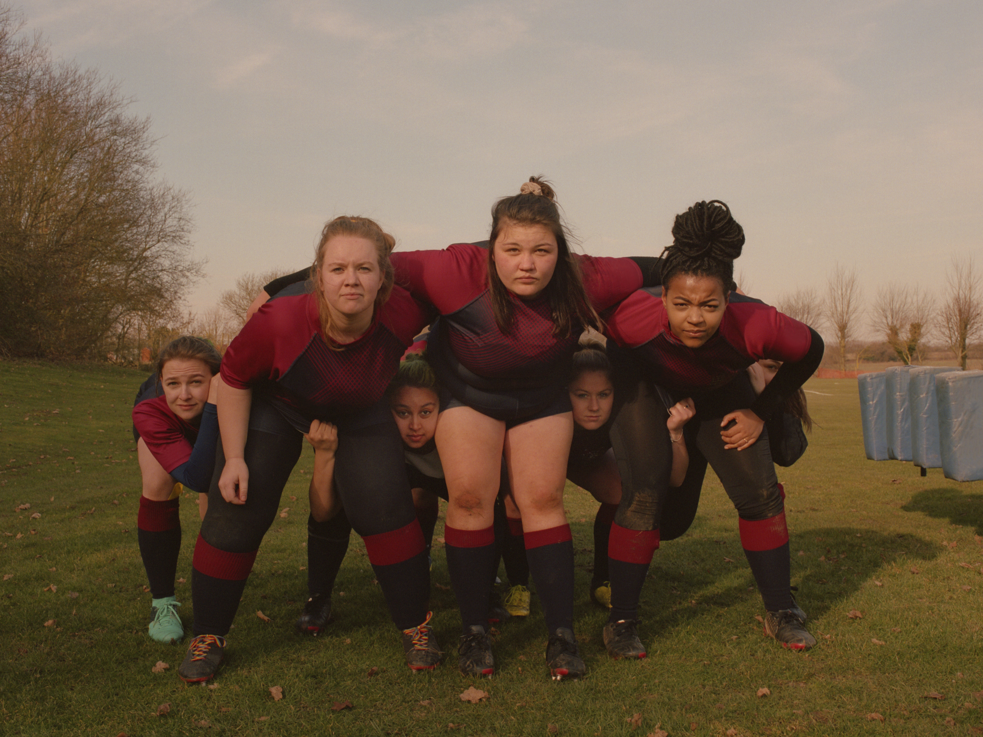
Scrum Refresher
Sprint Planning
Daily Scrum
Sprint Review
Sprint Retrospective
source: https://resources.scrumalliance.org/Article/scrum-events

Slide 8
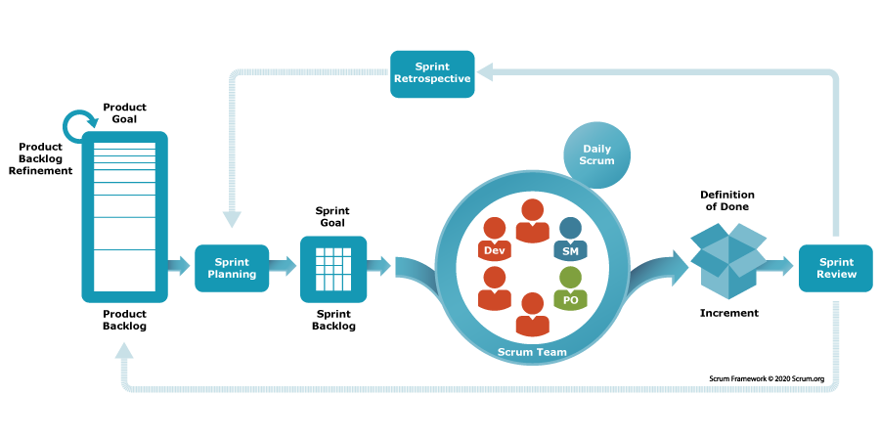
Scrum Refresher
source: https://resources.scrumalliance.org/Article/scrum-events

Slide 9
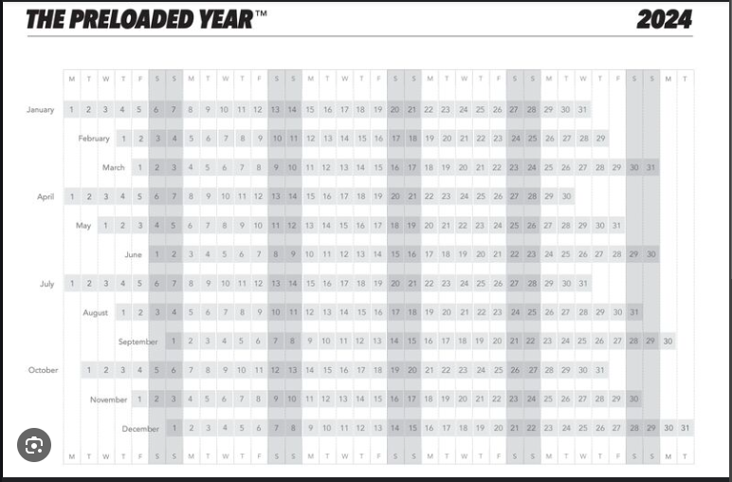
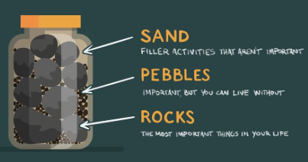
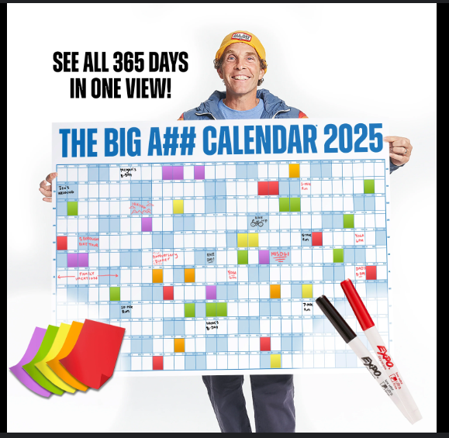
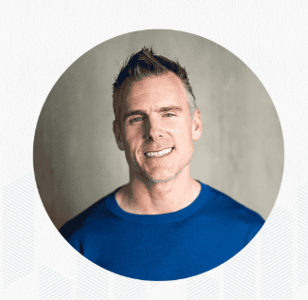
Audit Yourself
Design your perfect day
Compound to create your perfect week
Build a weekly schedule (known events/meetings/appointments)
Eat that frog! (schedule difficult/unappealing tasks in the morning or when you have the most energy)
Energy management vs. Time management
Design your day/week/year (Itzler, Ballantyne, Martell - Big rocks vs. little rocks)

Slide 10
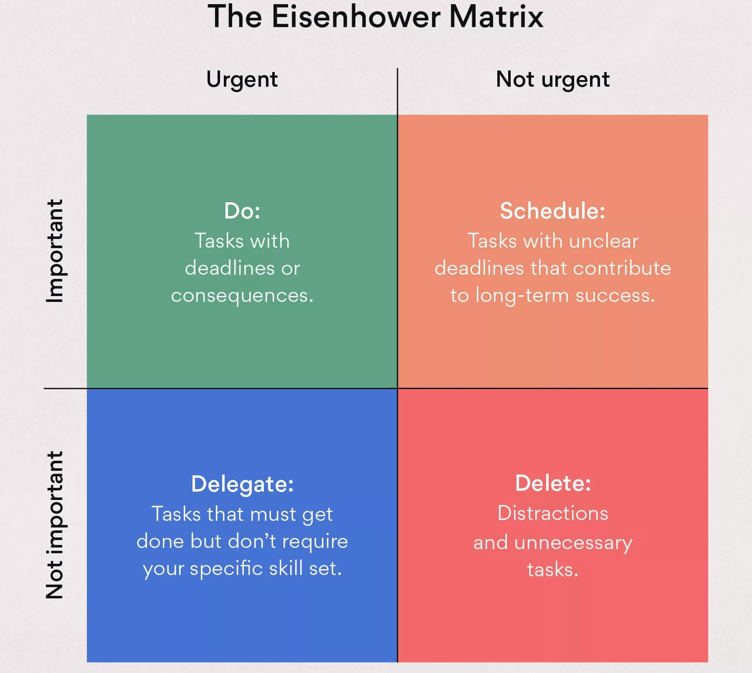
Personal Productivity

Slide 11
OneNote
A tool to build your second brain (BASB)
Alternatives:
Evernote
Notion
Obsidian
Showing its age, but still very useful (surprisingly so!)
Notebooks
Sections
Pages
Templates ← the most important feature for our topic
Notes (🪟+ Alt + N)
Loop integration
Copilot

Slide 12
A Lap Around OneNote
Notes:
Notebooks (unlimited)
Sections (section limit: none , section groups (like folders))
Pages/sub-pages (pages limits: 2 subpages)
Templates

Slide 13
Personal Productivity
Yearly
Weekly
Monday vision
Week at a Glance
Friday reflection (what went well, what went not so well, continue doing, stop doing)
Daily
Minimum time for tasks (as opposed to maximum)
Tiny habits (ridiculously small actions builds habits, not monumental investments)
Outcomes (results that would define success for the day)
Tasks (to-do items that are not outcomes)
Learning sprints
Action lists: Daily outcomes, weekly outcomes, scripts, queues
Reference lists: Ideas, notes, monthly outcomes (*GTD: get things out of your head)
*https://gettingthingsdone.com/
James clear https://gettingthingsdone.com/
Notes:
Min: eating, sleeping, working out

Slide 14
Team/Organization Tools
Loop demo…
source: https://resources.scrumalliance.org/Article/scrum-events

Slide 15
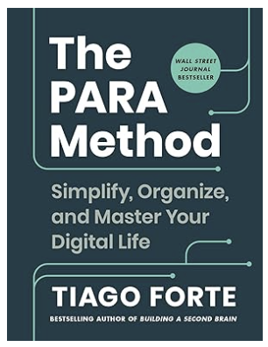
👑🗾 Side Quest
🧠
The PARA Method
Projects
Areas
Resources
Archive
source: https://www.buildingasecondbrain.com/para
Notes:
Projects: A collection of time-bound tasks that are actively tracked and worked on (work projects, home projects, vacations, volunteer event, etc.)
Areas: On-going collection of tasks that are actively tracked and worked on (health, wealth, relationships, etc.)
Resources: Supporting, interesting, or references information that is not directly tracked in projects or areas (coffee, sprouting, manual photography, martial arts, etc.)
Archive: Holding space for anything not actively tracked (items could be moved back into projects or areas.

Slide 16
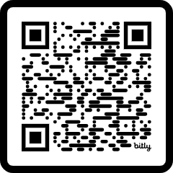
Thank you for attending! Please reach out with any questions!
Davis G. Trent
Principal Consultant
davis@mach11.co
https://bit.ly/M1125M365CD

Slide 17


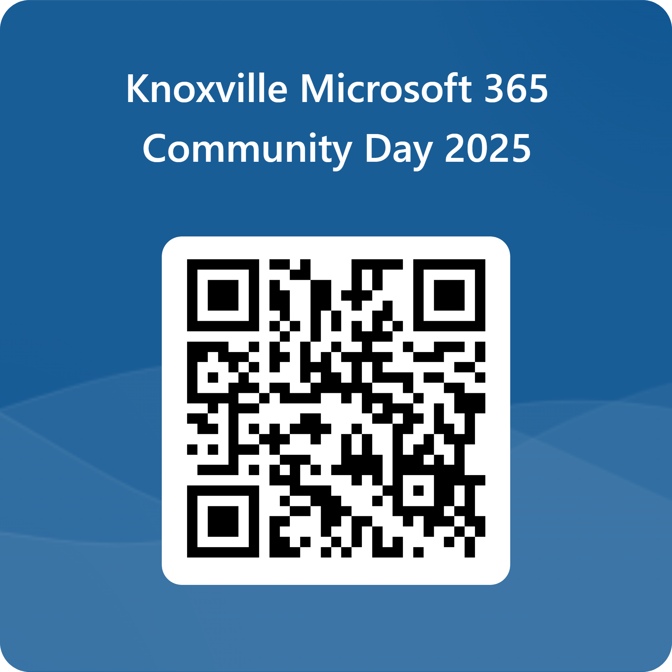








Knoxville Microsoft Community Days
Special Thanks to Our Sponsors
FEEDBACK
Thank You Valued Contributors!

Slide 18
https://smoky-mtn-brewery.com/locations/maryville/
Smokey Mountain Brewery
743 Watkins Rd, Maryville, TN 37801
Smokey Mountain Brewery Google Plus Code:
Q224+7G
Maryville, TN, USA

